Slide 1

Smart On-Street Parking Part 2
Made by:
Vladut PANAITE 1111154
Adrien COSTANDI 1110995

Slide 2
Requirements
Database to store user information and context information from context broker
Rest API for Front-End Application
Rest API for Context Broker
Front-End Application

Slide 3
Implementation Steps:
Retrieving & process data from camera using AI
Setting up the Orion Context Broker and Cygnus
Implementation of the Rest API (back-end)
Implementation of the Client Application (front-end)
Testing with fake data input
Testing with real data input
Setting up the camera & raspberry pi

Slide 4
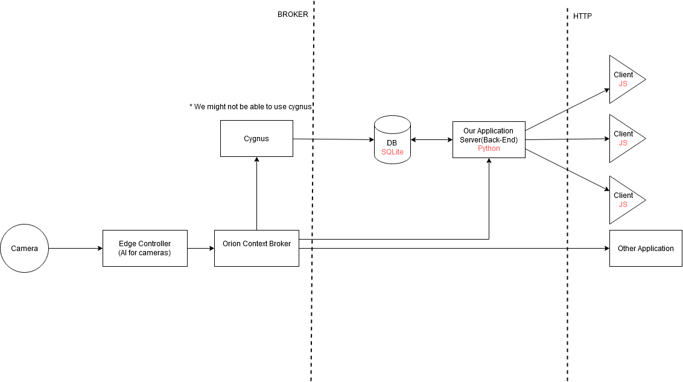
Architecture

Slide 5
Functionalities:
detection of illegal parking
notify law enforcers about illegal parking around the city
offering suggestion about available parking spots
offering statistics to the municipality about the most crowded streets

